Slide 1
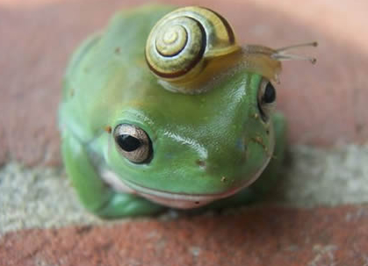
Practitioners Intensive
Day 2 Welcome Back!
Appropriate, dignified, accessories are important to one’s image

Slide 2
The Ultimate Truth Statement
A Powerful Contract with Yourself

Slide 3
Use the UTS to:
Deal with hard-to-measure issues: clutter, procrastination, being stuck, weight, addictions
Easily identify core issues: by identifying obstacles (limiting beliefs and fears) in the way
Attract love, money or health, and ….
Red Alert

Slide 4
As well as…
Quickly achieve goals:
- getting clean and sober, being on time or responsible
- being a great parent, becoming prosperous
- reaching ultimate performance levels
Stay focused on goal: instead of fretting over what you don’t have (or have and don’t want)
Easily “harness” the Law of Attraction

Slide 6
Home Environment
Enriched Relationships
Define an area of your life you would like to improve …
Health or Weight
Career or Wealth
Notes:
Pick one thing in each of these areas in your life that you would like to attract or improve
Home (or apartment)
Career or Money
Relationships
Body or Health:
Pick one of those improvements you want to work on today

Slide 7
UTS
1) Write out a simple statement about one of your desires…
“I want to make $150,000 a year.”
“I want do everything on a timely basis.”
“I want a successful Pro EFT practice.”
“I want to find my soul mate.”
“I want to gracefully end this relationship.”
Notes:
1) Write down how your life will be different when you get your desire (more time, increased energy, more options, freedom, etc.)
2) Add in the emotions, ie. how you will FEEL differently (happy, accomplished, peace of mind, joy in life, security, confidence, etc.)
3) Define their UTS
4) Give believability a rating 1 to 10, with 10 that you own it and believe it now.
5) Identify what’s in the way of owning the statement now
Set aside UTS and work on obstacle in the way; fear, don’t deserve it, can’t figure out how to make it happen, etc.

Slide 8
UTS
2) Jot down phrases about how your life will be different when you have what you want:
Can travel… Be independent… Buy new home… Have great relationships… Can make a bigger difference…
Notes:
1) Write down how your life will be different when you get your desire (more time, increased energy, more options, freedom, etc.)
2) Add in the emotions, ie. how you will FEEL differently (happy, accomplished, peace of mind, joy in life, security, confidence, etc.)
3) Define their UTS
4) Give believability a rating 1 to 10, with 10 that you own it and believe it now.
5) Identify what’s in the way of owning the statement now
Set aside UTS and work on obstacle in the way; fear, don’t deserve it, can’t figure out how to make it happen, etc.

Slide 9
UTS
3) Add emotions to your statement: how you will “FEEL” when you reach your goal
Confident – Free – Happy- Secure
Infinite choices – Joyful - Peace of mind
Sense of accomplishment – Worthy, etc.
Notes:
1) Write down how your life will be different when you get your desire (more time, increased energy, more options, freedom, etc.)
2) Add in the emotions, ie. how you will FEEL differently (happy, accomplished, peace of mind, joy in life, security, confidence, etc.)
3) Define their UTS
4) Give believability a rating 1 to 10, with 10 that you own it and believe it now.
5) Identify what’s in the way of owning the statement now
Set aside UTS and work on obstacle in the way; fear, don’t deserve it, can’t figure out how to make it happen, etc.

Slide 10
UTS
4) Put it all 3 elements together in a powerful statement…
State your desire as if it’s already here (present tense.) Changing “I want” to “I am” or “I have…”
Describe the (projected) differences in your life, having reached your goal
Add the emotions you will feel
Notes:
1) Write down how your life will be different when you get your desire (more time, increased energy, more options, freedom, etc.)
2) Add in the emotions, ie. how you will FEEL differently (happy, accomplished, peace of mind, joy in life, security, confidence, etc.)
3) Define their UTS
4) Give believability a rating 1 to 10, with 10 that you own it and believe it now.
5) Identify what’s in the way of owning the statement now
Set aside UTS and work on obstacle in the way; fear, don’t deserve it, can’t figure out how to make it happen, etc.

Slide 11
UTS Example
“I have joy, confidence and freedom knowing I’m attracting $150,000 every year! I have infinite choices, can take my family to Hawaii and feel great about my financial security.
Woo Hoo!
Notes:
1) Write down how your life will be different when you get your desire (more time, increased energy, more options, freedom, etc.)
2) Add in the emotions, ie. how you will FEEL differently (happy, accomplished, peace of mind, joy in life, security, confidence, etc.)
3) Define their UTS
4) Give believability a rating 1 to 10, with 10 that you own it and believe it now.
5) Identify what’s in the way of owning the statement now
Set aside UTS and work on obstacle in the way; fear, don’t deserve it, can’t figure out how to make it happen, etc.

Slide 13
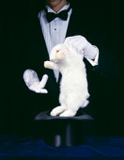
5. Add Magic Phrases to the beginning & end
 Begin with a gratitude statement: “Thank you Universe for allowing me to … (add your statement here)
 End with ease statement: “I’m grateful that this has been so fun and easy!”

Slide 14
Magic Phrase Example 1
Thank you Universe for allowing me to reach my weight goals so quickly. I feel healthy, vibrant and full of energy. I look great in my clothes and feel good about myself. I’m so happy that this has actually been enjoyable and easy!
Notes:
1) Write down how your life will be different when you get your desire (more time, increased energy, more options, freedom, etc.)
2) Add in the emotions, ie. how you will FEEL differently (happy, accomplished, peace of mind, joy in life, security, confidence, etc.)
3) Define their UTS
4) Give believability a rating 1 to 10, with 10 that you own it and believe it now.
5) Identify what’s in the way of owning the statement now
Set aside UTS and work on obstacle in the way; fear, don’t deserve it, can’t figure out how to make it happen, etc.

Slide 15
Magic Phrase Example 2
I’m very grateful for the joy, confidence and freedom I have with my own business. I gross $500,000 every year and have infinite choices. I can comfortablely buy things for my parents and children and feel secure about my financial success. I’m surprised how this has been so effortless and pleasurable.
Notes:
1) Write down how your life will be different when you get your desire (more time, increased energy, more options, freedom, etc.)
2) Add in the emotions, ie. how you will FEEL differently (happy, accomplished, peace of mind, joy in life, security, confidence, etc.)
3) Define their UTS
4) Give believability a rating 1 to 10, with 10 that you own it and believe it now.
5) Identify what’s in the way of owning the statement now
Set aside UTS and work on obstacle in the way; fear, don’t deserve it, can’t figure out how to make it happen, etc.

Slide 16
Summary of the UTS
Part 1
1) Write a SIMPLE statement about a goal
2) Describe how your LIFE will be different
3) Describe how you will FEEL differently as you progress toward your goal
4) Combine 1, 2 & 3 in a powerful, positive, and present-tense statement
5) Add the 2 magic phrases (gratitude and simplicity)
Red Alert
Notes:
Write down how your life will be different when you get your desire (more time, increased energy, more options, freedom, etc.)
2) Add in the emotions, ie. how you will FEEL differently (happy, accomplished, peace of mind, joy in life, security, confidence, etc.)
3) Define their UTS
4) Give believability a rating 1 to 10, with 10 that you own it and believe it now.
5) Identify what’s in the way of owning the statement now
Set aside UTS and work on obstacle in the way; fear, don’t deserve it, can’t figure out how to make it happen, etc.
1) Set aside UTS and work on obstacle in the way; fear, don’t deserve it, can’t figure out how to make it happen, etc.

Slide 17
Break

Slide 18
The Ultimate Truth Statement Part 2
Identifying & Eliminating Blocks in Your Way

Slide 19
1) Rate the believability or ownership of your statement
(10 being highly believable to 0 meaning No Way!)
UTS Part 2
Notes:
1) Write down how your life will be different when you get your desire (more time, increased energy, more options, freedom, etc.)
2) Add in the emotions, ie. how you will FEEL differently (happy, accomplished, peace of mind, joy in life, security, confidence, etc.)
3) Define their UTS
4) Give believability a rating 1 to 10, with 10 that you own it and believe it now.
5) Identify what’s in the way of owning the statement now
Set aside UTS and work on obstacle in the way; fear, don’t deserve it, can’t figure out how to make it happen, etc.

Slide 20
2) Identify any emotional blocks in the way (usually fears and limiting beliefs)
Fear of: failing, succeeding, rejection
Beliefs that: it’s going to be too hard, it’ll take too long… I’m too old…
… it’s not safe, I need to figure out how
UTS Part 2
Notes:
1) Write down how your life will be different when you get your desire (more time, increased energy, more options, freedom, etc.)
2) Add in the emotions, ie. how you will FEEL differently (happy, accomplished, peace of mind, joy in life, security, confidence, etc.)
3) Define their UTS
4) Give believability a rating 1 to 10, with 10 that you own it and believe it now.
5) Identify what’s in the way of owning the statement now
Set aside UTS and work on obstacle in the way; fear, don’t deserve it, can’t figure out how to make it happen, etc.

Slide 21
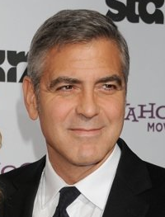
Facts vs. Beliefs and Fears
Facts are documented truths:
The sun rises in the east
Humans need oxygen to survive
Gravity keeps us from floating away
George Clooney is handsome
Downton Abbey is the best PBS program…ever!

Slide 22
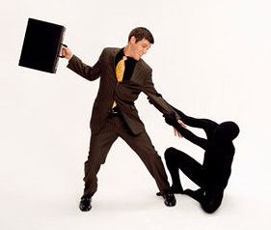
Facts vs. Beliefs
Limiting beliefs are partial truths (derived from experiences,) paired with partial facts:
I don’t have a degree, therefore…
my income is limited…I’m not as respected…
I’m not as smart as those with degrees
I have a disability, therefore…
… I can’t find a good job… No one wants to hire a cripple… I have no way to get to work…What if I couldn’t last all day?
Red Alert

Slide 23
The Erroneous Chain of Logic
Bad things have happened to me… 
➲  therefore I’m not safe…
and if I stay fearful and hyper-vigilant  
➲  then I can keep bad things from happening
➲  and then I’ll be safe!
Red Alert

Slide 24
Facts vs. Beliefs and Fears
I’ve never been good at managing money (F)
… I won’t ever be good at handling money (B)
My knee pain is from a deteriorated disc (F)
… I’ll never be able to get rid of it. (B)
My illness is from a disease, not an emotional issue (F…maybe)
…. Tapping can’t cure it or make me feel better (B)

Slide 25
3) Bundle the obstacles (fears and beliefs) and give them a “pull factor”
10 means a strong attachment to limiting beliefs and fears.
Zero is none
UTS Part 2
Notes:
1) Write down how your life will be different when you get your desire (more time, increased energy, more options, freedom, etc.)
2) Add in the emotions, ie. how you will FEEL differently (happy, accomplished, peace of mind, joy in life, security, confidence, etc.)
3) Define their UTS
4) Give believability a rating 1 to 10, with 10 that you own it and believe it now.
5) Identify what’s in the way of owning the statement now
Set aside UTS and work on obstacle in the way; fear, don’t deserve it, can’t figure out how to make it happen, etc.

Slide 26
4) Do a Reversal Set-up on your fears or beliefs
“Even though these fears and beliefs keep me from getting what I want, there’s a part of me…”
UTS Part 2
Notes:
1) Write down how your life will be different when you get your desire (more time, increased energy, more options, freedom, etc.)
2) Add in the emotions, ie. how you will FEEL differently (happy, accomplished, peace of mind, joy in life, security, confidence, etc.)
3) Define their UTS
4) Give believability a rating 1 to 10, with 10 that you own it and believe it now.
5) Identify what’s in the way of owning the statement now
Set aside UTS and work on obstacle in the way; fear, don’t deserve it, can’t figure out how to make it happen, etc.

Slide 27
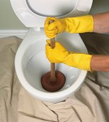
5) Tap away the blockages…
Use the Golden Gate technique template to tap away the fears, beliefs, doubts, worries, other obstacless
UTS Part 2
Notes:
1) Write down how your life will be different when you get your desire (more time, increased energy, more options, freedom, etc.)
2) Add in the emotions, ie. how you will FEEL differently (happy, accomplished, peace of mind, joy in life, security, confidence, etc.)
3) Define their UTS
4) Give believability a rating 1 to 10, with 10 that you own it and believe it now.
5) Identify what’s in the way of owning the statement now
Set aside UTS and work on obstacle in the way; fear, don’t deserve it, can’t figure out how to make it happen, etc.

Slide 28
Demo

Slide 29
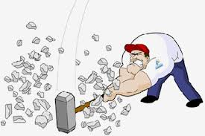
Dyads on Busting Beliefs and Fears
Find a partner
Decide who starts as “A” (Coach)
Switch Roles when time is up
Notes:
Dyads to Practice Bundling Baggage
1 Find a partner and introduce yourself
2 Put your chairs together facing each other
3 Decide who is partner A (the coach), / (partner B is the “client”)

Slide 30
UTS Part 2
6) When your obstacles are at a 0, reassess your ownership of UTS
(10 is complete ownership)
Notes:
1) Write down how your life will be different when you get your desire (more time, increased energy, more options, freedom, etc.)
2) Add in the emotions, ie. how you will FEEL differently (happy, accomplished, peace of mind, joy in life, security, confidence, etc.)
3) Define their UTS
4) Give believability a rating 1 to 10, with 10 that you own it and believe it now.
5) Identify what’s in the way of owning the statement now
Set aside UTS and work on obstacle in the way; fear, don’t deserve it, can’t figure out how to make it happen, etc.

Slide 31
7) Trouble shoot: what’s keeping
your UTS from being a
UTS Part 2
?
Notes:
1) Write down how your life will be different when you get your desire (more time, increased energy, more options, freedom, etc.)
2) Add in the emotions, ie. how you will FEEL differently (happy, accomplished, peace of mind, joy in life, security, confidence, etc.)
3) Define their UTS
4) Give believability a rating 1 to 10, with 10 that you own it and believe it now.
5) Identify what’s in the way of owning the statement now
Set aside UTS and work on obstacle in the way; fear, don’t deserve it, can’t figure out how to make it happen, etc.

Slide 32
Trouble shooting: If the ownership of your UTS is above 8…
It’s most likely Reluctance to Committing

Slide 33
Problem: Reluctance to Committing
Solution: Do 2-3 rounds alternating: “Any remaining resistance to owning my statement … I choose to abolish it”

Slide 34
Trouble shooting: If your UTS is below an 8 …
… then you still have some, beliefs, fears or obstacles in the way

Slide 35
Solution: identify what’s still holding you back and do a couple of rounds tapping it away:
“I choose to release any remaining ___________ that’s keeping me from owning my statement …”

Slide 36
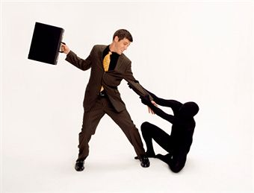
Tap Away Any and All Remaining Limiting Beliefs or Fears
Until ownership of the UTS is at a 10!

Slide 37
8. Tap on your UTS twice a day
… to stay focused on your goal…..
…Which helps keep you in the right vibration to receive your desire!
Notes:
1) Give the obstacle an intensity from 1 – 10 (with 10 being intense, 0 it’s gone)
9:45-10:15
NOW do demo with someone on UTS
10:15- -10 minute break – return to start dyad work
Dyads to work on impediment/what’s in the way of believing UTS 100%
10:30-11:00
Partner A is coach
30 minutes each partner – Assistants help them out
11:05-11:35 – Partner B is coach
11:30 Break
11:40-12:25 Sharing and Q & A
12:30-1:45 Lunch

Slide 38
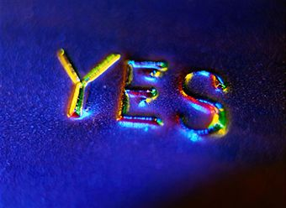
Expect it
Believe it
Receive it

Slide 39
Red Alert
UTS Part 2 Summary
Rate the believability of your UTS
Identify the fears and beliefs in your way
Bundle the ‘obstacles’ together and give them a 10-0 intensity rating
Do a Reversal Neutralization
Tap away the obstacles
Go back and reassess the UTS
If not at a 10, trouble shoot until you own the statement
Tap on your UTS daily, 2 times
Notes:
1) Write down how your life will be different when you get your desire (more time, increased energy, more options, freedom, etc.)
2) Add in the emotions, ie. how you will FEEL differently (happy, accomplished, peace of mind, joy in life, security, confidence, etc.)
3) Define their UTS
4) Give believability a rating 1 to 10, with 10 that you own it and believe it now.
5) Identify what’s in the way of owning the statement now
Set aside UTS and work on obstacle in the way; fear, don’t deserve it, can’t figure out how to make it happen, etc.

Slide 41
Lunch Time
Please eat with others
Please be back by 1:45

Slide 42
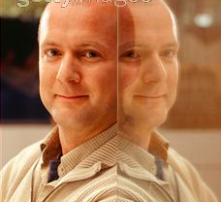
The Two faces of Pro EFT™
Red Alert
Science of Tapping
20+ Pro EFT Techniques
Managing a practice
Referring to others
Marketing & promoting
Using a “formula”
The tapping points
Research about tapping
Art of Tapping
Reframing/Pre-framing
Trusting what to say
Establishing rapport
Using intuition
Muscle testing
Sensitivity to others
Humor & metaphors
Usage of techniques

Slide 43
The Art of Tapping

Slide 44
Establishing Rapport
Red Alert
Creates a connection with the client
Allows others to feel comfortable with you
Is a precursor to establishing trust

Slide 45
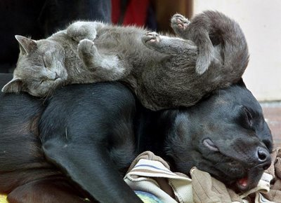
Rapport Leads to Trust
Trust leads to feeling safe
If clients feels safe, they will:
Be honest with themselves and you
Relax and feel comfortable
Open up to you
Be free to explore
Likely to accept humor and reframing

Slide 46
Ways to Create Rapport
Make easy eye contact
Smile and pretend to look friendly
Find common ground; hobbies, home town, friends, interests
Remember and use their name often

Slide 47
More Ways to Create Rapport
Ask simple questions & respond genuinely
Pay attention to the pace & energy and match it
Share something about yourself, especially if it relates to something they have said
Listen to what they are saying and repeat it back

Slide 48
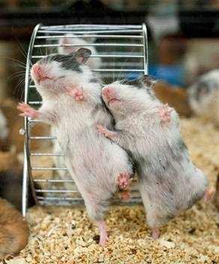
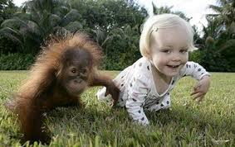
Enhancing Rapport
mirroring / matching:
Body language:
- Crossed arms, legs, eyes
Breathing patterns
Gestures… movements

Slide 49
Enhancing Rapport
matching the clients’
Speaking patterns;
- voice tonality
- pace / rhythm
- volume
Facial expressions
Energy

Slide 50
Practice establishing rapport
Dude,You are SO good- looking!

Slide 51
You can break rapport by…
Purporting to know what the client is thinking
instead: pose any insights as questions or “what ifs”
Making the client feel wrong instead: support them or reframe

Slide 52
Other ways to break rapport
Judge them: “WTF were you thinking! instead: accept them where they are… “That must have been a challenging time for you.”
Making disapproving gestures or facial expressions instead: simply acknowledge what they tell you…
“I hear you… or I understand”

Slide 53
Practice breaking rapport

Slide 54
Break

Slide 55
Dyads doing the UTS… while establishing rapport

Slide 56
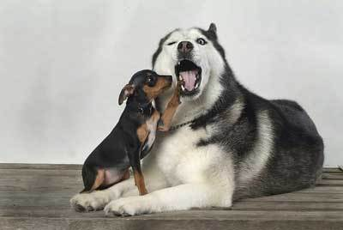
You might wanna do somethin’ about that molar, Fluffy
Pick a partner to practice UTS with tonight
Get a good night’s sleep
Eat a healthy breakfast tomorrow
Please be in your seats by 8:55 a.m.

